Slide 1

React Native Training
Learn once, write everywhere

Slide 2
A brief history of React Native
Started as Facebook’s internal hackathon project, in the summer of 2013, RN has since become one of the most popular frameworks
In March of 2015, Facebook announced at F8 that React Native is open and available on GitHub.
Notes:
F8 est une conférence annuelle organisé par Facebook, F8= Facebook 8 hours hackathons

Slide 3
What is React Native?
A framework for building native mobile apps using JavaScript and React.
Build cross platform (Android/iOS)
Uses the same fundamental building blocks as a native app built with Java (Android) or Swift/Objective-C (iOS)
Notes:
React (React.js) is a Javascript library for building interactive User Interfaces on the Web

Slide 4
What is not React Native?
React Native apps are not hybrid apps,
Do not run in a WebView
Not a mobile web app, No HTML, No CSS, ONLY JAVASCRIPT
Notes:
Hybrid apps are web apps that run in a native container called WebView

Slide 5
Why React Native?
Cross Platform
Save massive amounts of Time and Money
Open Source, has a large community
Easier to learn and code
Notes:
1- Because building native apps is hard, because of the different stacks of technologies (Java Android/ Swift iOS), no konwledge and code sharing,,,
Talk about the problems of react native

Slide 6
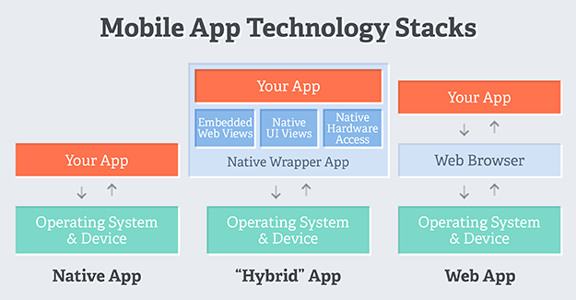
Native Vs Hybrid Vs Web Apps

Slide 7
Setting up Dev Environement
Git : https://git-scm.com/
Node & npm : https://nodejs.org/en/
Yarn : npm install –g yarn
Create-react-native-app: npm install –g create-react-native-app
VSCode: https://code.visualstudio.com/
Expo in the mobile devices https://play.google.com/store/apps/details?id=host.exp.exponent&hl=fr

Slide 8
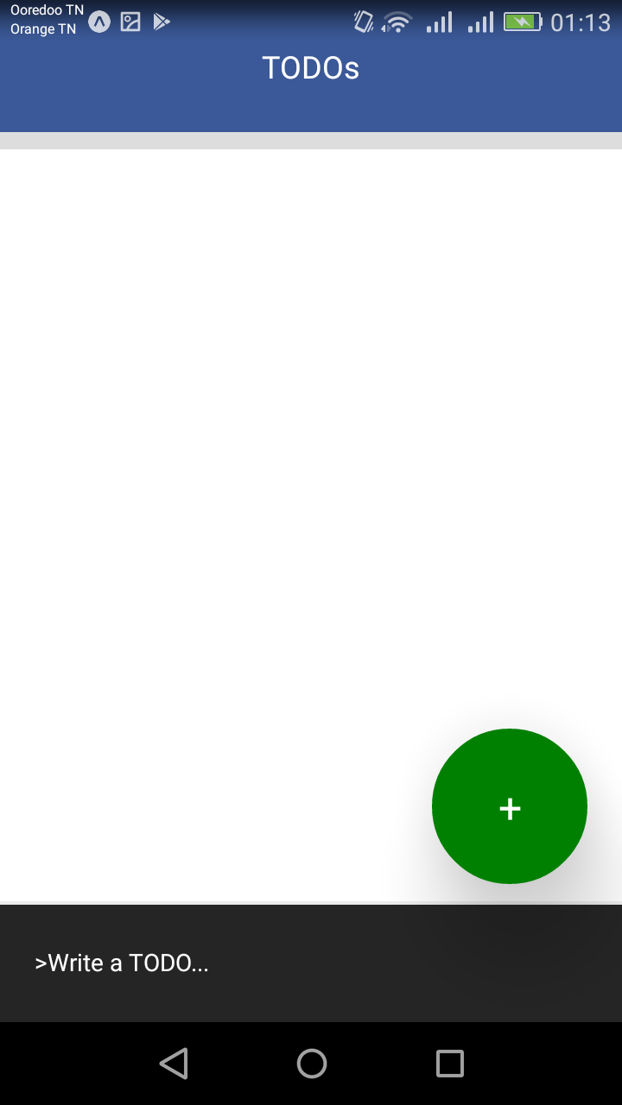
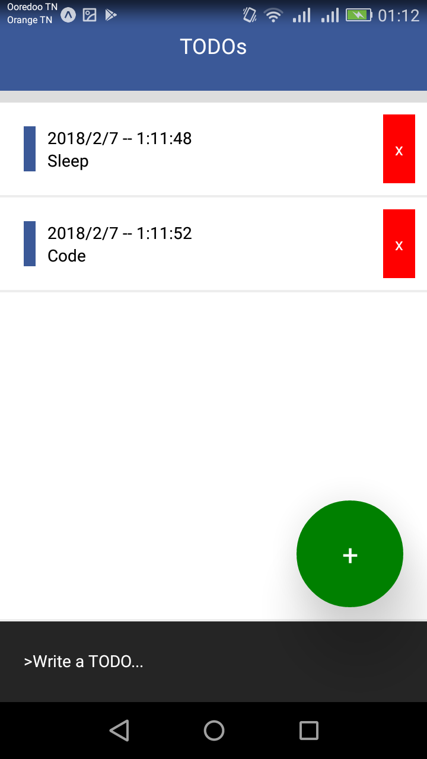
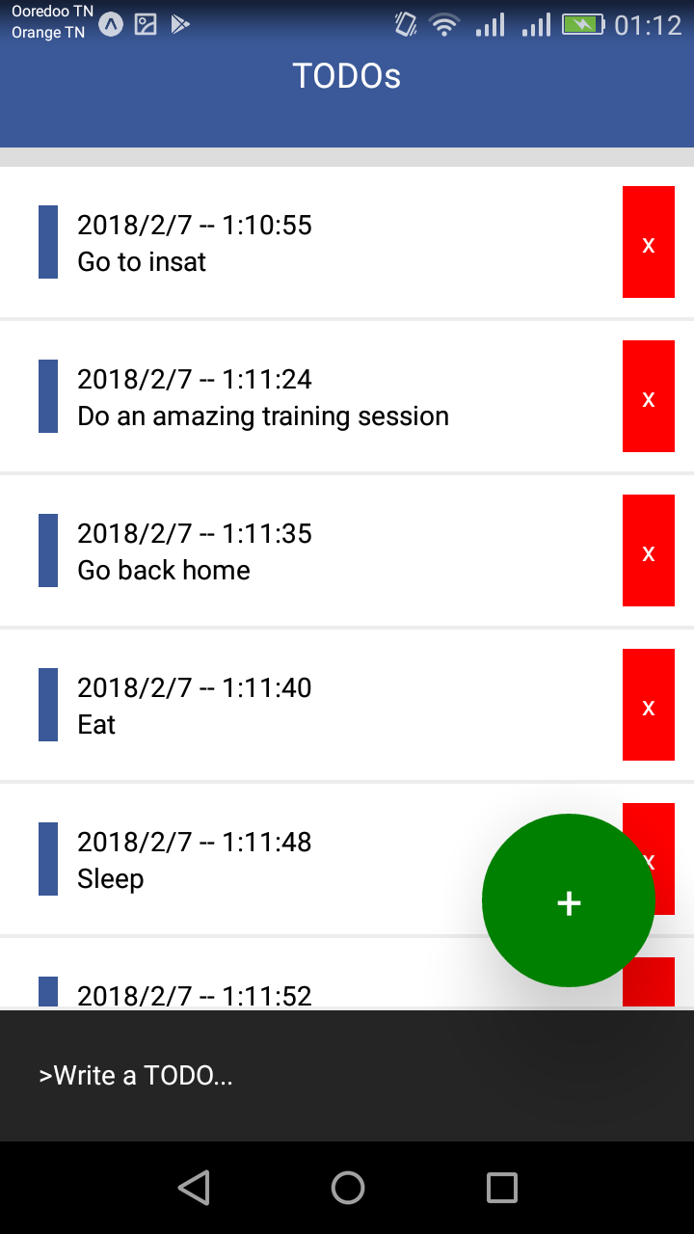
Demo: TODO App

